Slide 1
QM – BW Reconciliation

Slide 2

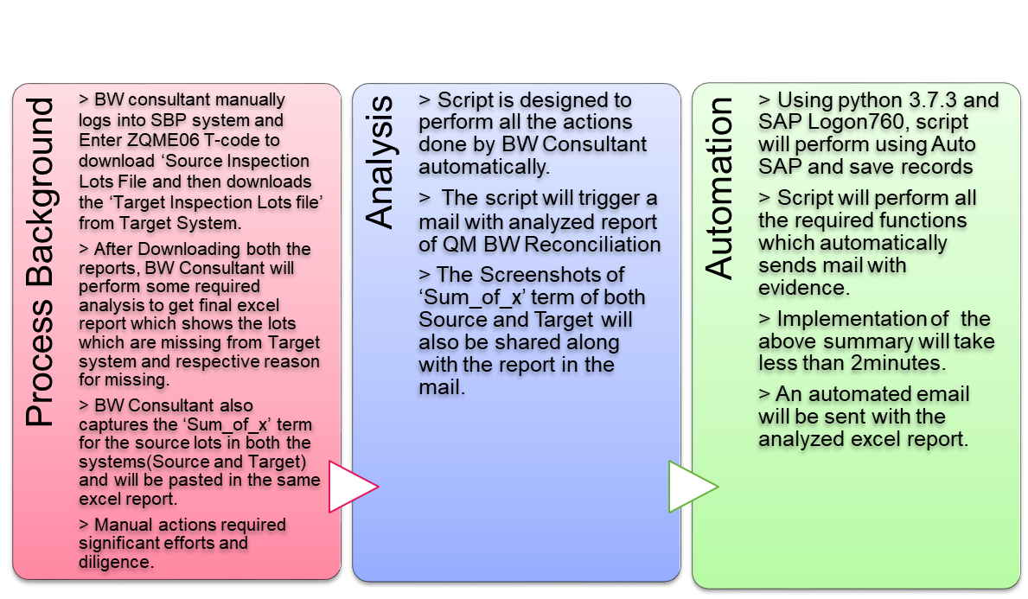
QM – BW Reconciliation
Business Value
94%
  Reduction in execution time
100%
  Data Accuracy
Zero
  Manual intervention
Evidence
  Better Documentation
2 Hours
  Efforts saved per month-If Monitored Weekly

Slide 3
Automation Flow Chart:
Login to SBP (Through SAP Logon Pad)
Login to BIP (Through Java Web Portal)
Enter T-Code and give respective variant
Give respective start and end date
Download the Inspection Lots report (Source)
Download the Inspection Lots report (Target)
Login to SBP (Through SAP Logon Pad)
Capture the
‘Sum of X’ Field
Combine both the reports and perform analysis to get the output excel report
Send Mail with the Excel Report and Screenshots Attached.
Login to BIP (Through SAP Logon Pad)
Capture the
‘Sum of X’ Field
Logout from SBP and BIP

Slide 4
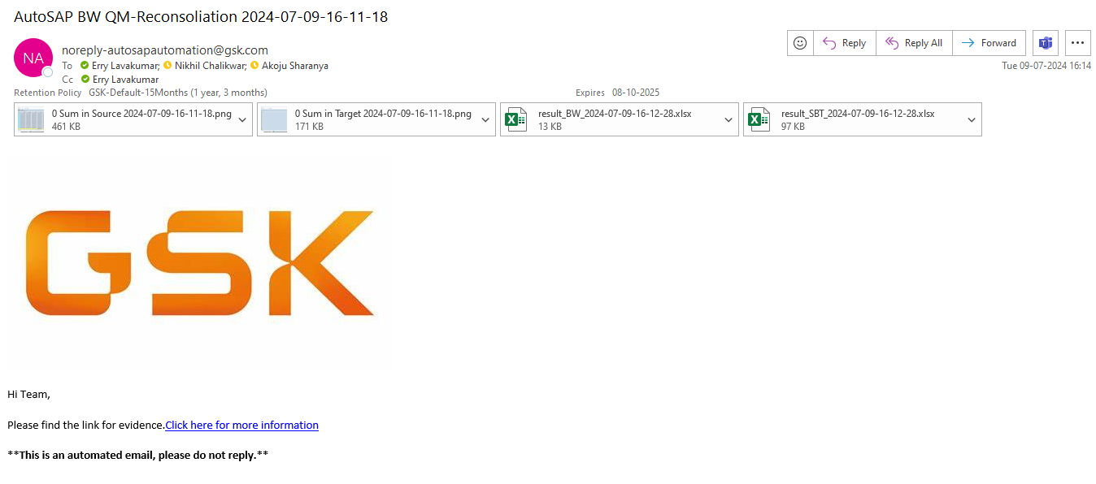
Mail Output:

Slide 5
Thank You

